Slide 1

HealthSync
Patient Appointment and Management System with Real-Time Analysis
D23CS102-Siddhit Kale
D23CS104-Denis Ruparel
D23CS108-Tanay Mahale
Under the Guidance of: Asst.Prof. Dr.Jigar Sarda

Slide 2
Welcome to the presentation on Patient Appointment and Management System with Real-Time Analysis
Our project is a web-based application that designed to manage patient appointments in real time. It allows patients to register, book, and manage appointments with doctors while also providing administrative tools for confirming, rescheduling, and canceling appointments and give real time analysis for improve patient care.

Slide 3
Why We Choose This Project
01
02
03
04
Rising Need for Efficient Healthcare Management
Addressing Errors and Inefficiencies in Manual Systems
Reducing Missed Appointments
Improving Operational Efficiency
By addressing these challenges, the project aims to create a more efficient, reliable, and patient-friendly healthcare system.

Slide 4
Problems Faced by Staff and Doctors (Without This System)
Problem 01
Problem 02
Manual Scheduling and Errors
High No-Show Rates
- : Issue :-
- : Issue :-
Manually record using paper logs or spreadsheets.
Forget their appointments without reminders. Staff must manually call patients, which is time-consuming.
- : Impact :-
Wasted time, increased burden.
- : Impact :-
Missed appointments lead to lost revenue.

Slide 5
Problems Faced by Staff and Doctors (Without This System)
Problem 03
Problem 04
Time-Consuming Registration Process
Increased Administrative Burden
- : Issue :-
- : Issue :-
Visit the facility or call to register and book appointments and leading to long queues.
confirming appointments, handling cancellations, and rescheduling take much time and effort.
- : Impact :-
- : Impact :-
Increased workload, Poor patient satisfaction.
Reduced efficiency, employee burnout, and less focus on critical tasks.

Slide 6
Problems Faced by Staff and Doctors (Without This System)
Problem 05
Problem 06
Poor Resource Management
Poor Patient Experience
- : Issue :-
- : Issue :-
Without clear data on appointment staff cannot efficiently allocate doctors
Patients face long wait times, difficulty booking appointments,
- : Impact :-
- : Impact :-
Leading to bottlenecks in healthcare delivery.
Patient dissatisfaction, reduced loyalty

Slide 7

What is the goal of the project
Reduce manual workload by automated scheduling, confirmations, and cancellations.
Digital tools to improve appointment management and patient care.
Boost Patient Engagement and Satisfaction
Minimize Missed Appointment

Slide 8




Types of Clients to Approach for the Project
Private Hospitals and Clinics
Multi-Specialty Healthcare Centers
Government Hospitals
Diagnostic Centers
and Labs

Slide 9


Project Objective and Flow of Data
Patient Registration and
Profile Management
Appointment Booking Managing, Scheduling, Cancellations
Automated Reminders and Notifications using SMS Service
Doctor and Staff Dashboard
Feedback and Reviews
Real-Time Analytics and Reporting
Appointment History and Tracking
Secure Data Management

Slide 10



Slide 11




Frontend & Backend
Database
Version Control

Slide 12





Devops
Data Visualization

Slide 13
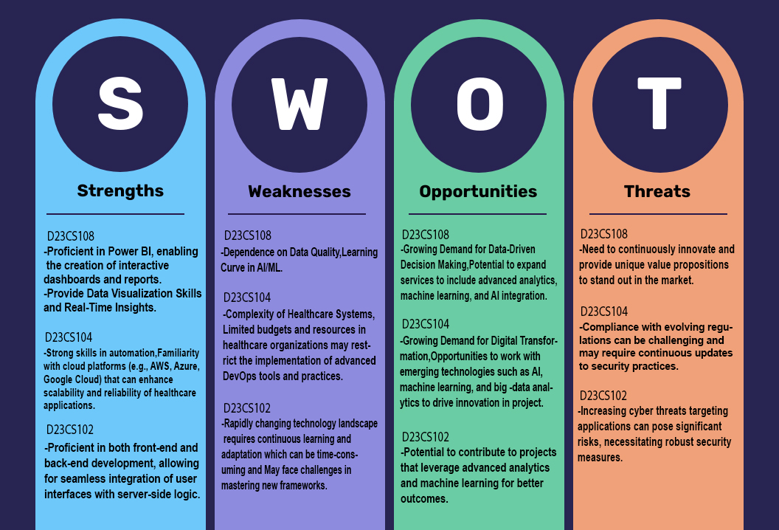
SWOT ANALYSIS

Slide 14
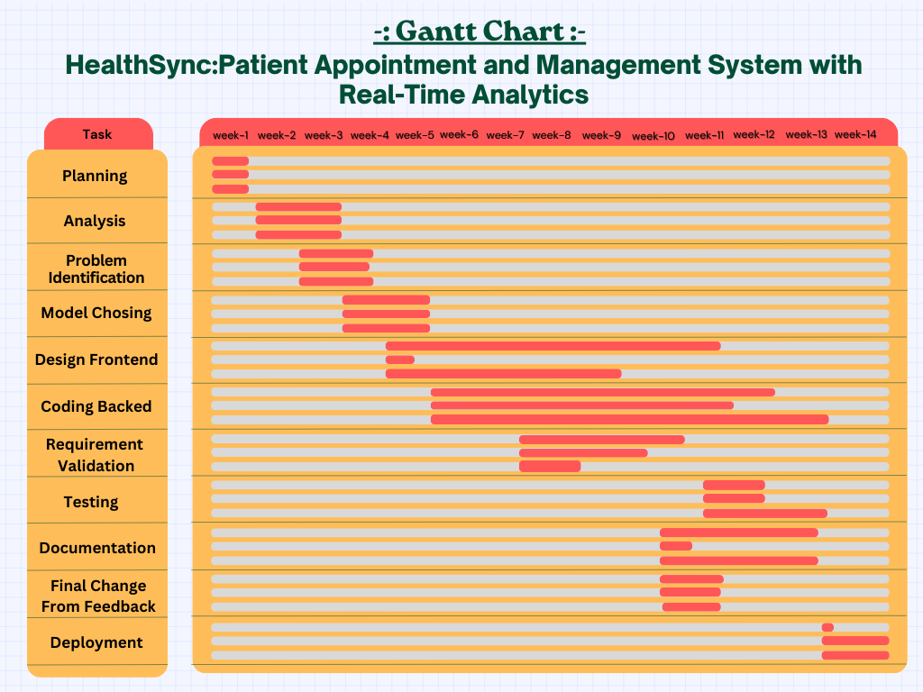
Gantt Chart

Slide 15


Slide 16
HealthSync
Patient Appointment and Management System with Real-Time Analysis
D23CS102-Siddhit Kale
D23CS104-Denis Ruparel
D23CS108-Tanay Mahale
Under the Guidance of: Asst.Prof. Dr.Jigar Sarda

